Slide 1


PREDICT
EMPLOYEE TURNOVER
WITH MACHINE LEARNING

Slide 2

AGENDA
Introduction
Data Collection
Data Wrangling
EDA / Data visualization
Feature selection
Modeling
Performance Assessment
Conclusion

Slide 3



About the project
To answer a big HR question re Employee Attrition
Determine the key factors to keep staff loyal / cut down turnover rate & overhead
INPUT – Employee info
OUTPUT - employee leaves ?
ML CLASSIFIER

Slide 4

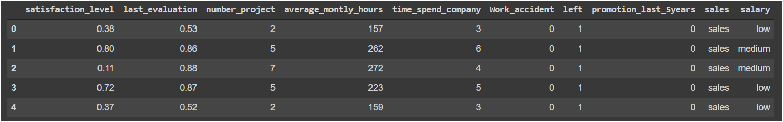
The dataset
14999 rows of employees‘ information, with 10 columns containing attributes of:
satisfaction_level (0–1)
last_evaluation (Time since last evaluation in years)
number_projects (Number of projects completed while at work)
average_monthly_hours (Average monthly hours at workplace)
time_spend_company (Time spent at the company in years)
Work_accident (Whether the employee had a workplace accident)
left (Whether the employee left the workplace or not (1 or 0)) - Label
promotion_last_5years (Whether the employee was promoted in the last five years) (1 or 0)
sales (Department in which they work for) - To Rename
salary (Relative level of salary)

Slide 5
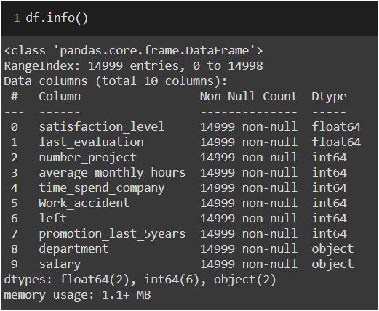
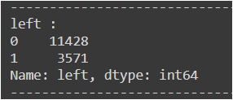
Data Wrangling
Rename columns : 'average_montly_hours', 'sales‘ -> ‘department’
Check Missing values – none
Imbalanced dataset of Left being outnumbered

Slide 6
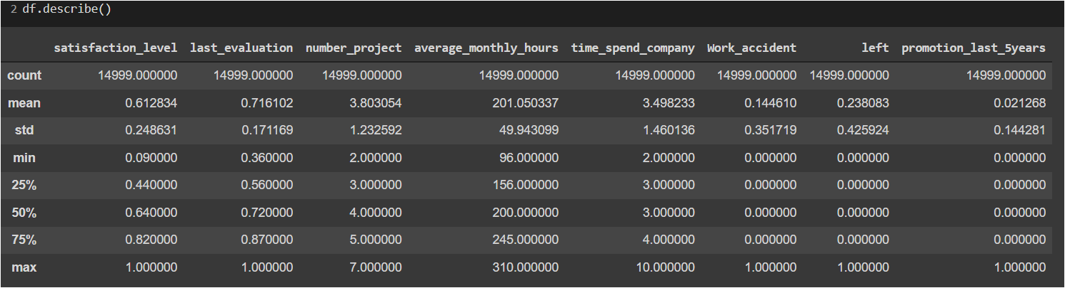
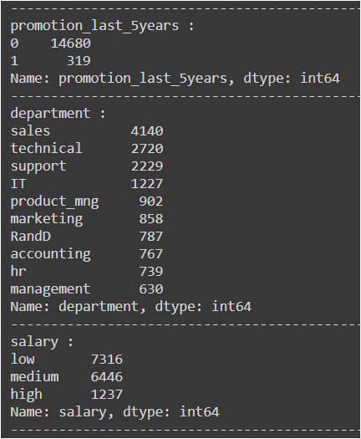
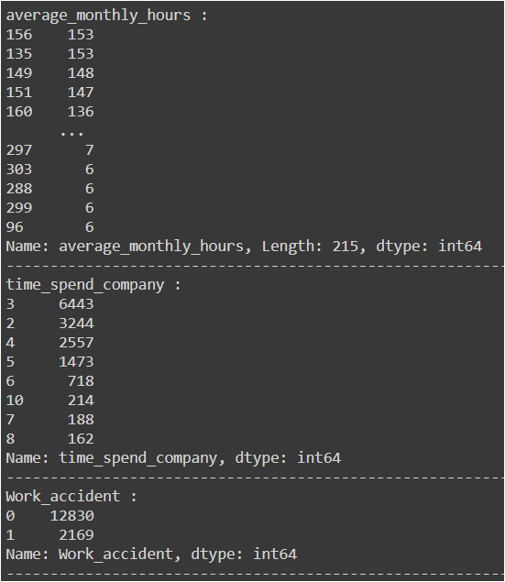
EDA
Data statistics
Check unique values and counts of them

Slide 7
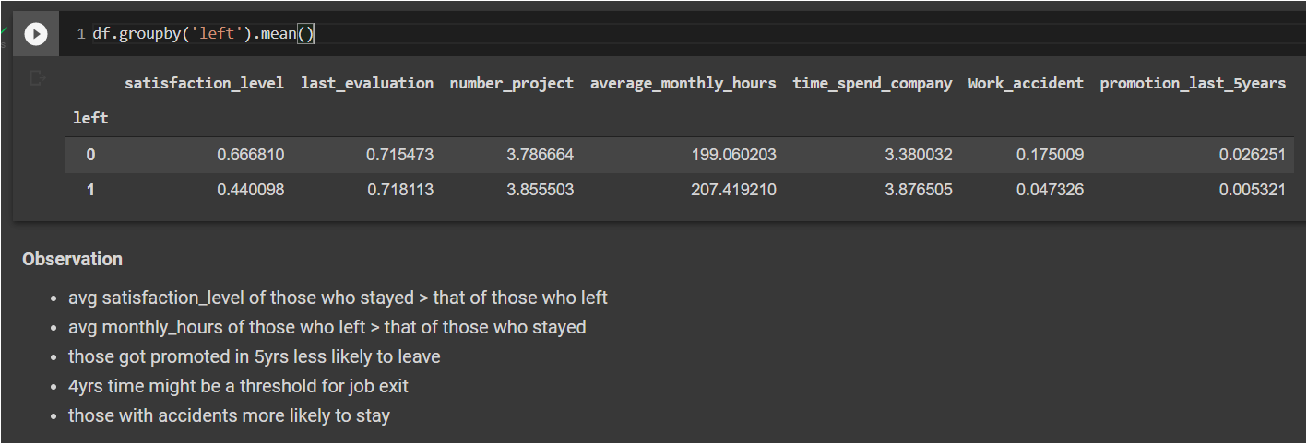
EDA Observation on categorical features “LEFT”

Slide 8
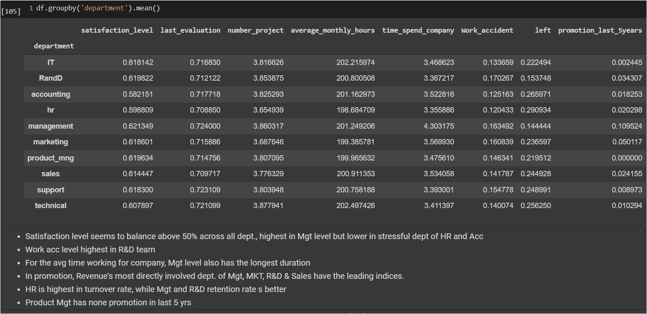
EDA – Observation on categorical features “DEPT.”

Slide 9
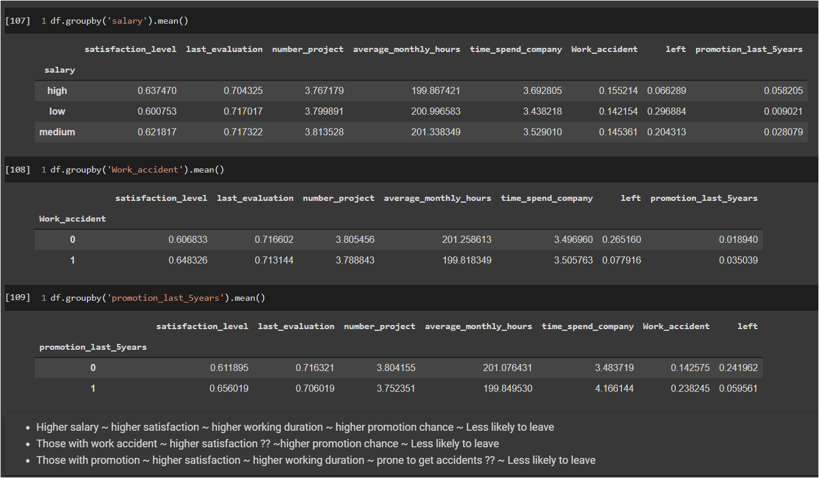
EDA – Observation on categorical features

Slide 10
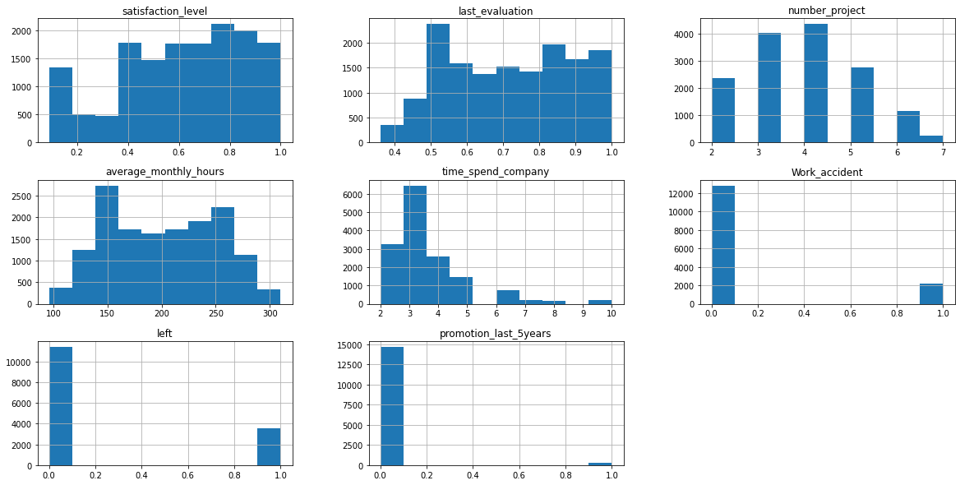
Visualization _ Data Distribution Histogram

Slide 11
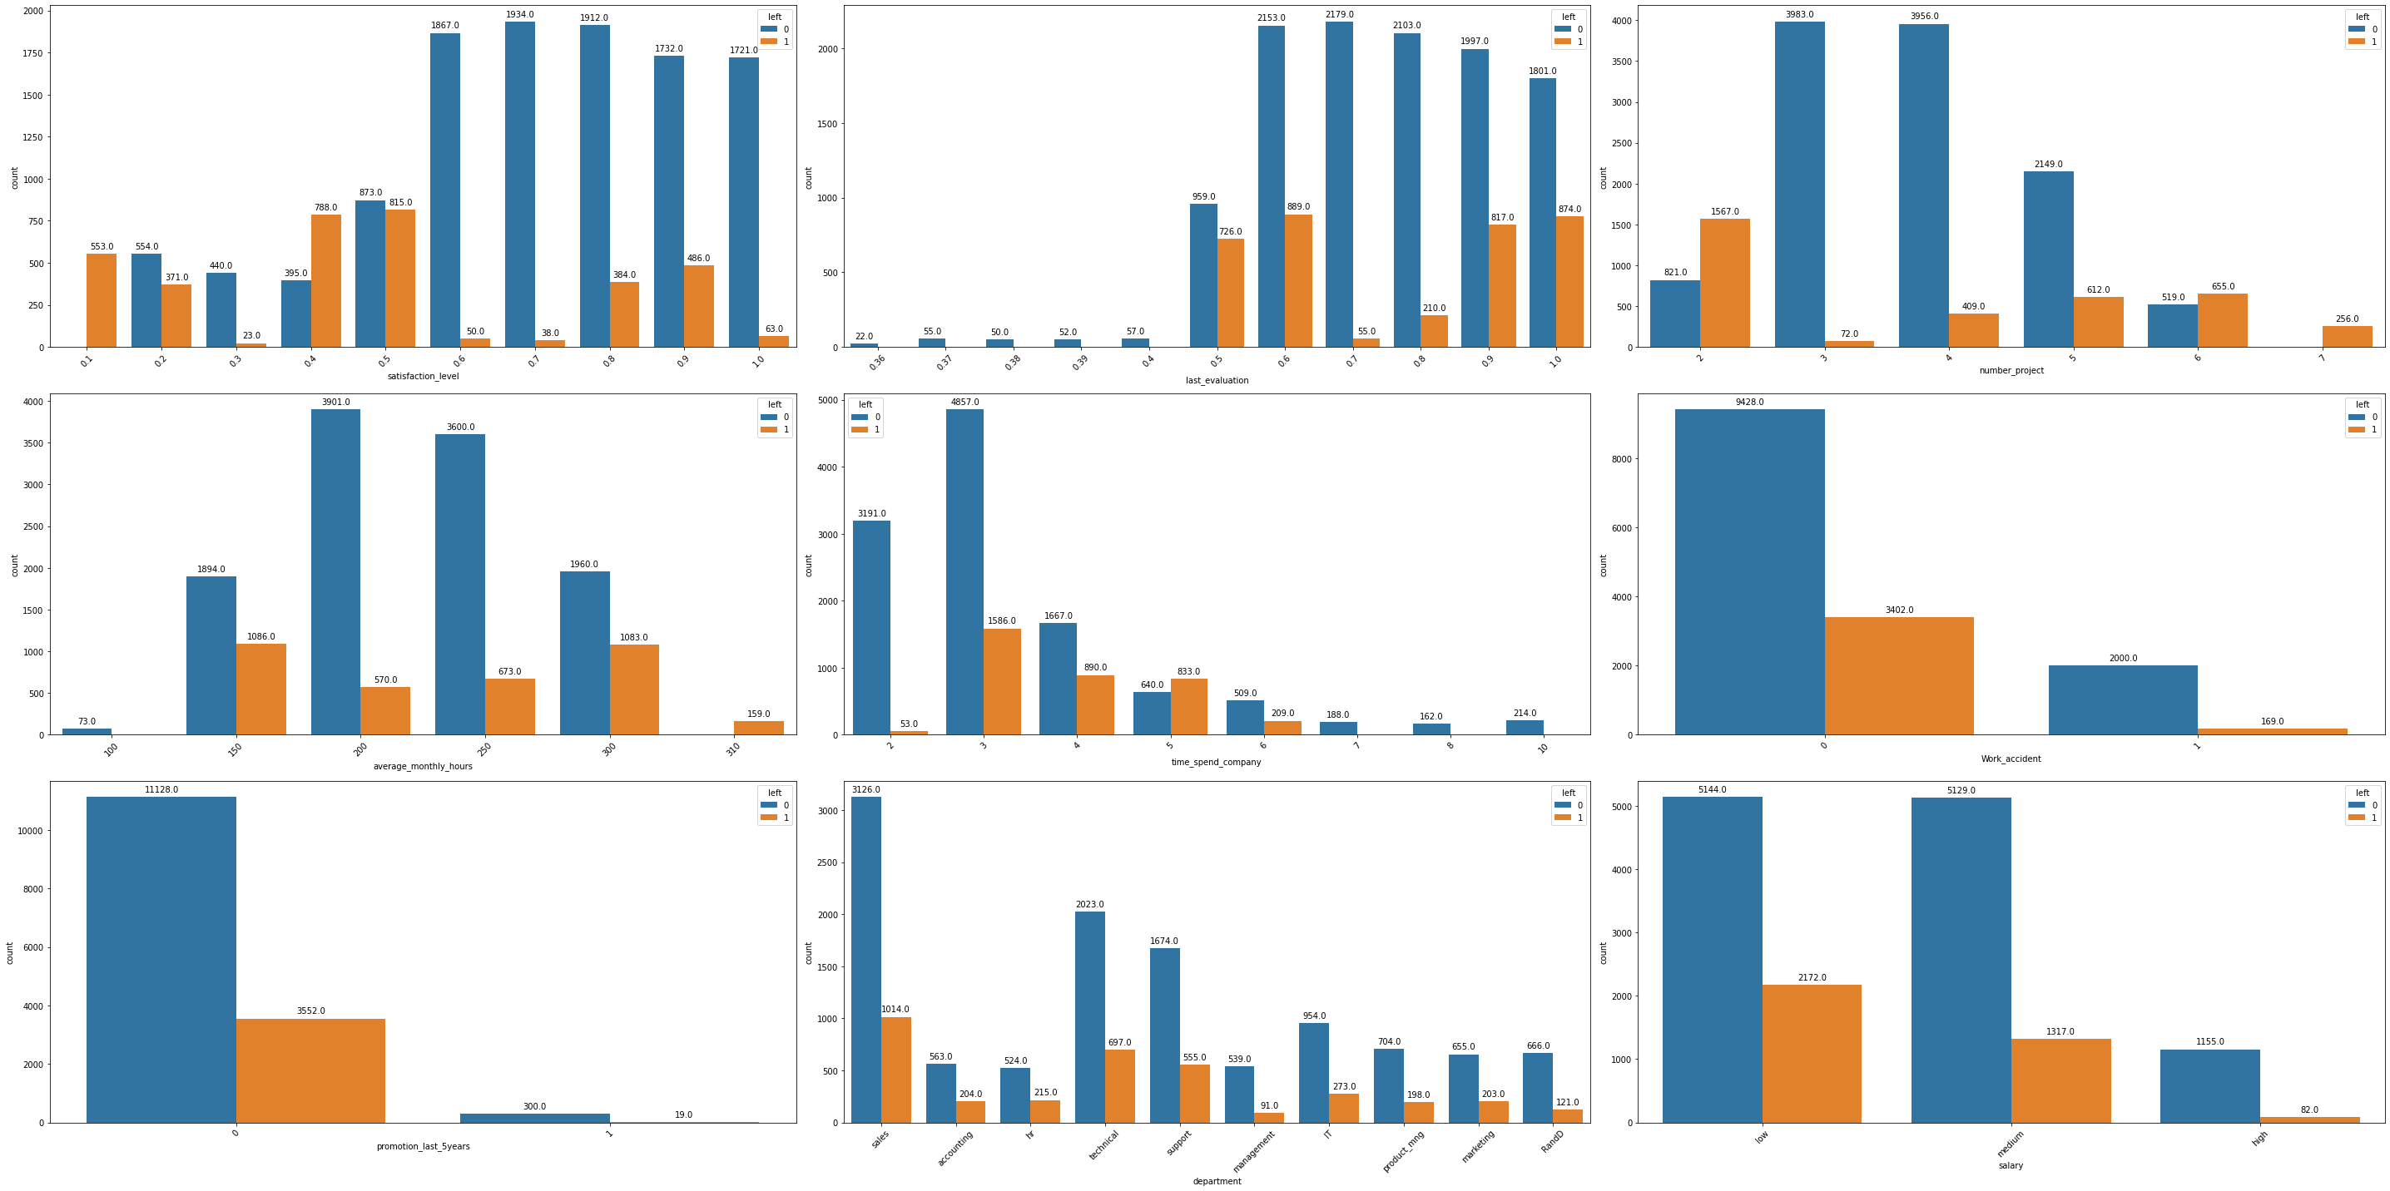
Visualization _ Left count across features values

Slide 12
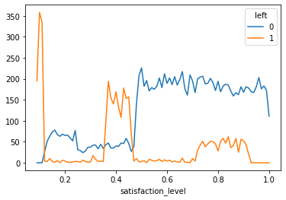
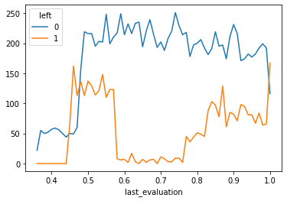
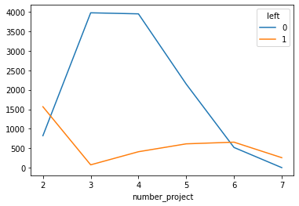
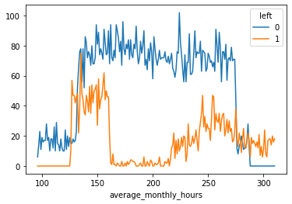
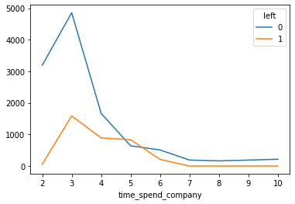
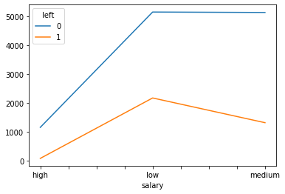
Visualization _ Left trend across features values

Slide 13
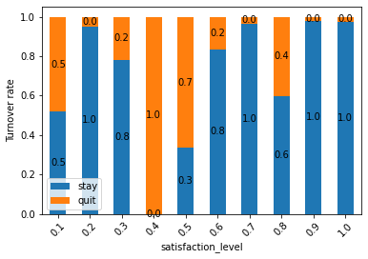
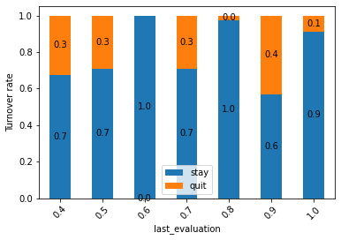
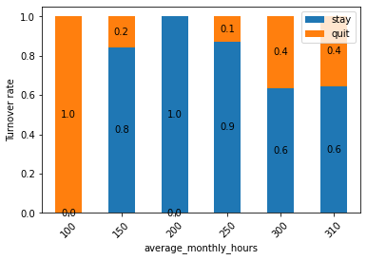
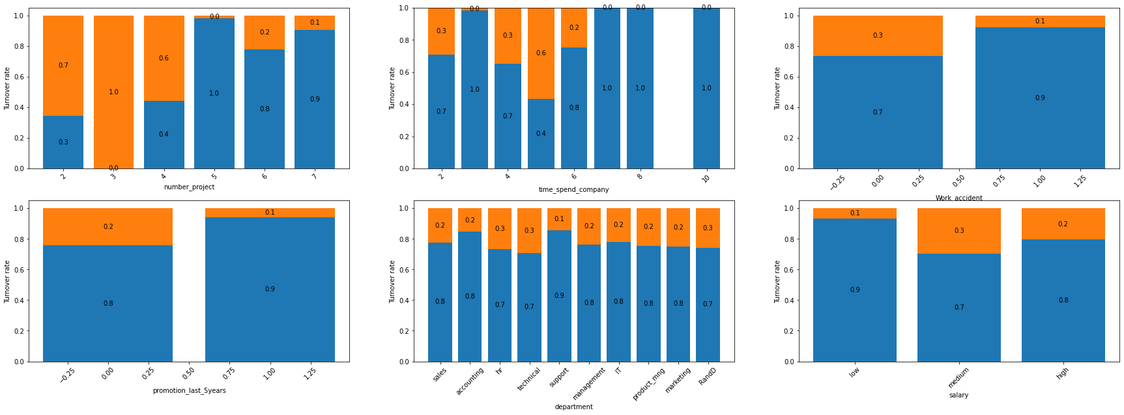
Visualization _ Turnover rate across features values

Slide 14
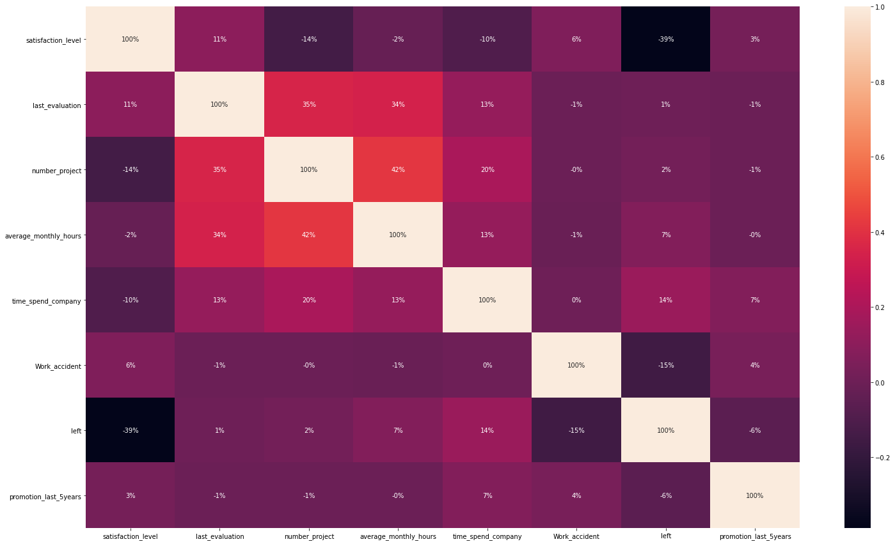
Visualization _ Feature correlation matrix

Slide 15
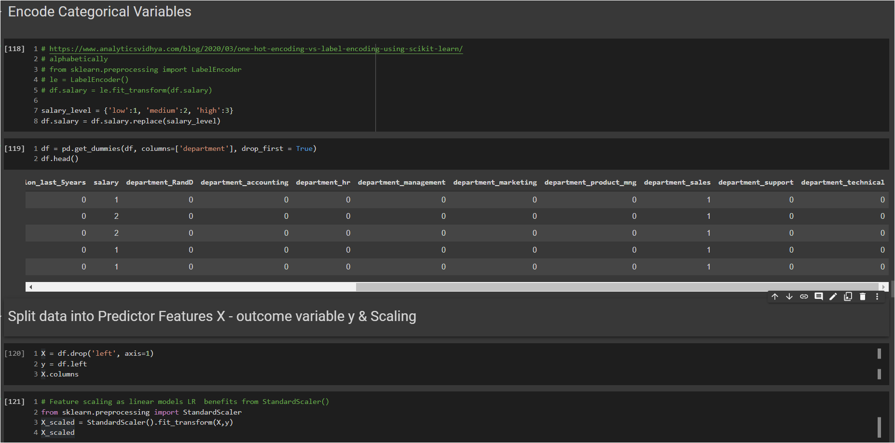
Data prep

Slide 16
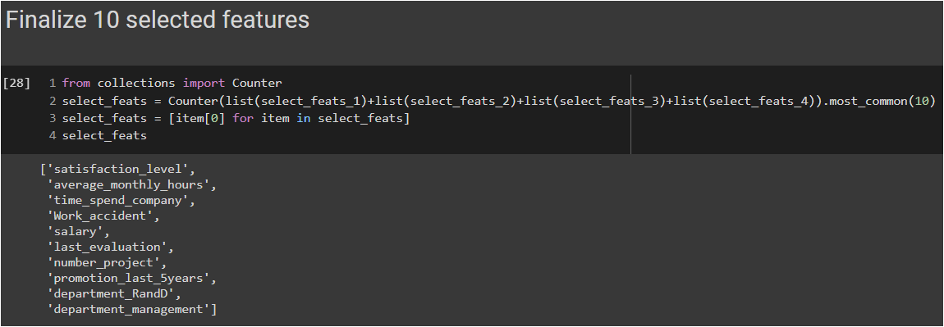
Feature Selection
R-style statistics P_value based
Recursive Feature Elimination (RFE) works by recursively removing variables and uses the model accuracy based on remained variables to identify significant variables
Lasso regularization L1 shrinks some of the coefficients to zero to remove less important features
Random forest Embedded function
SelectKBest

Slide 17
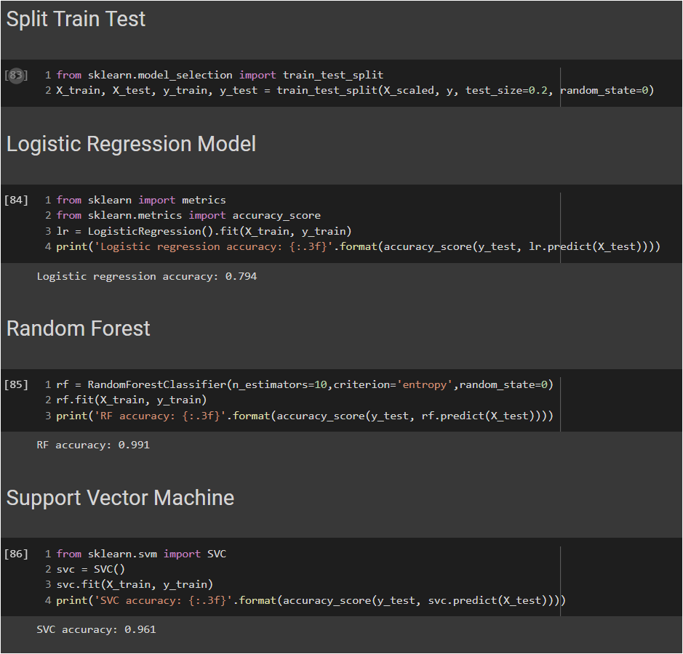
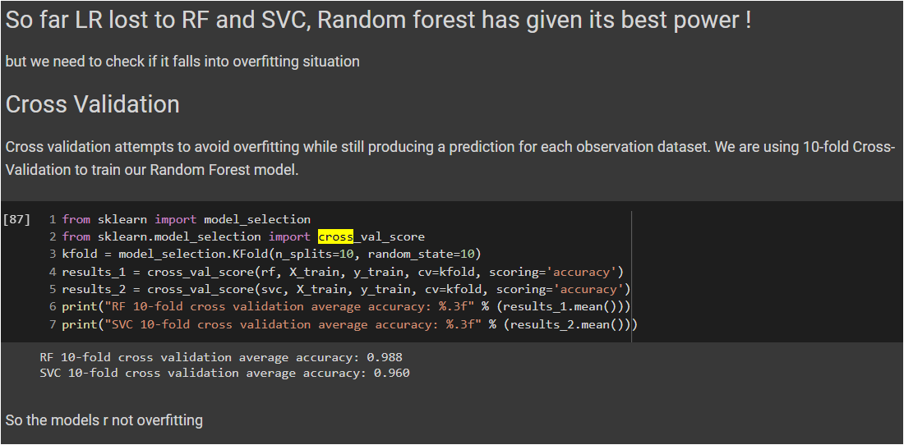
Modeling & cross validation

Slide 18
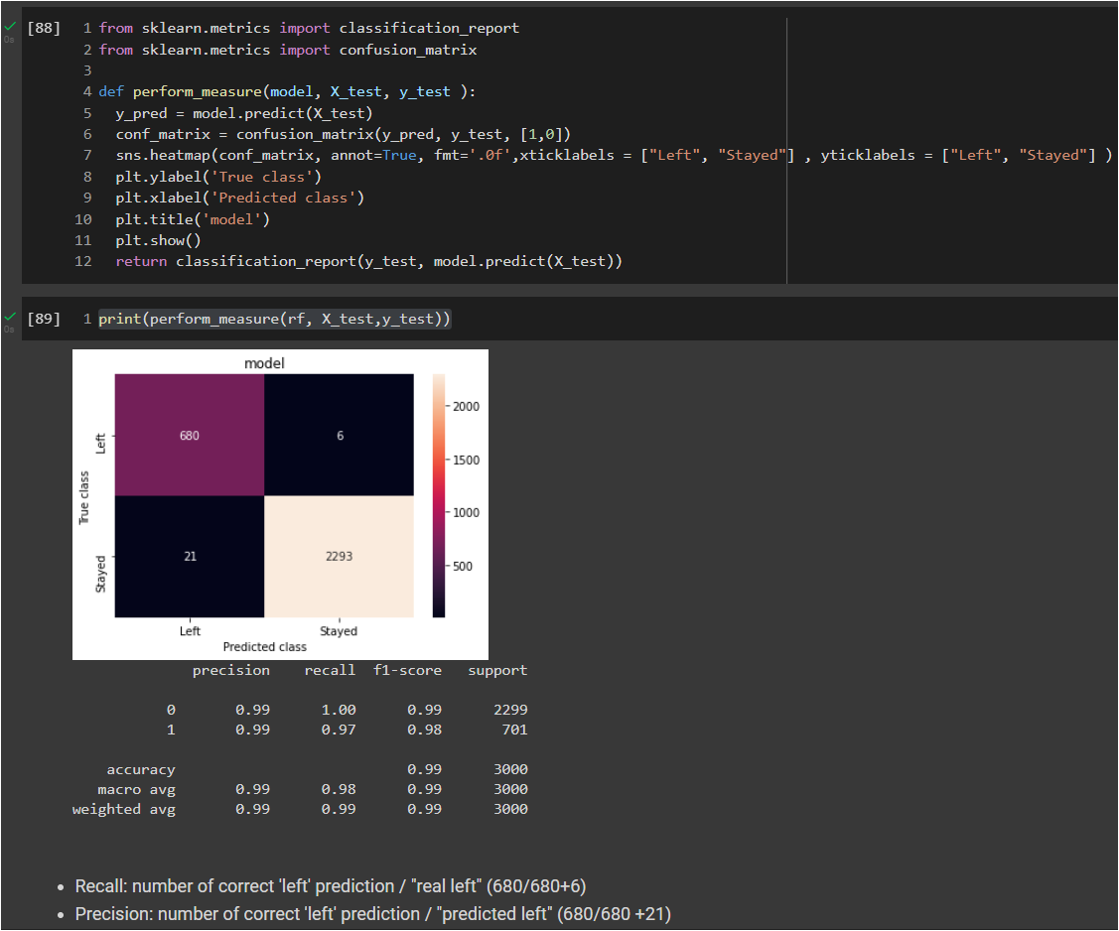
Confusion matrix

Slide 19
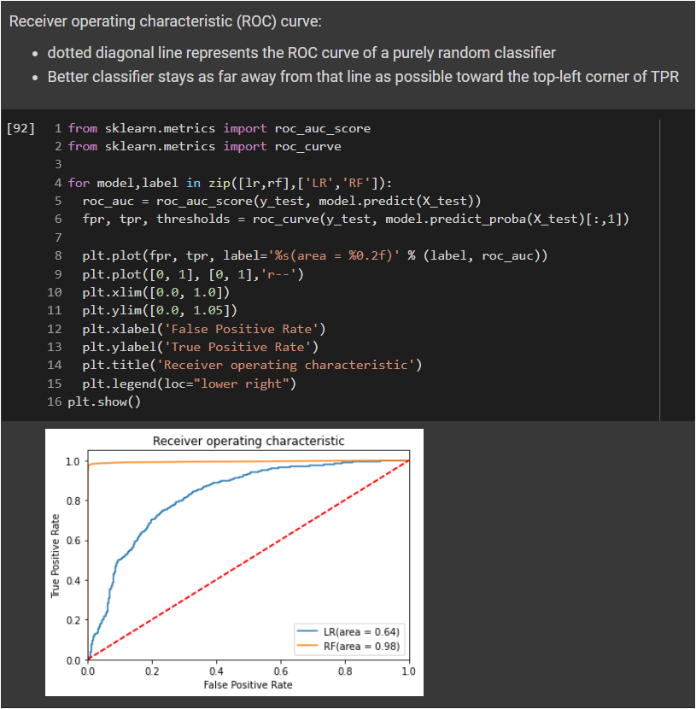
ROC curve

Slide 20
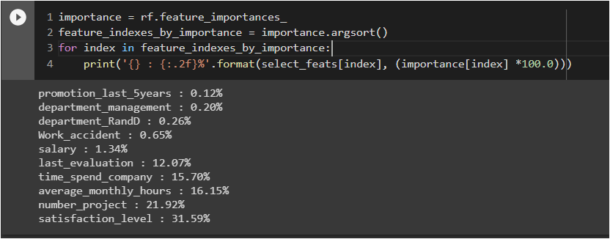
FEATURE IMPORTANCES

